Slide 1
The Fibonacci Sequence and the Golden Ratio
math is all around you.

Slide 2
Can we find a pattern?
1, 1, 2, 3, 5, …
8, 13, 21, 34, 55, …
What comes next?

Slide 3
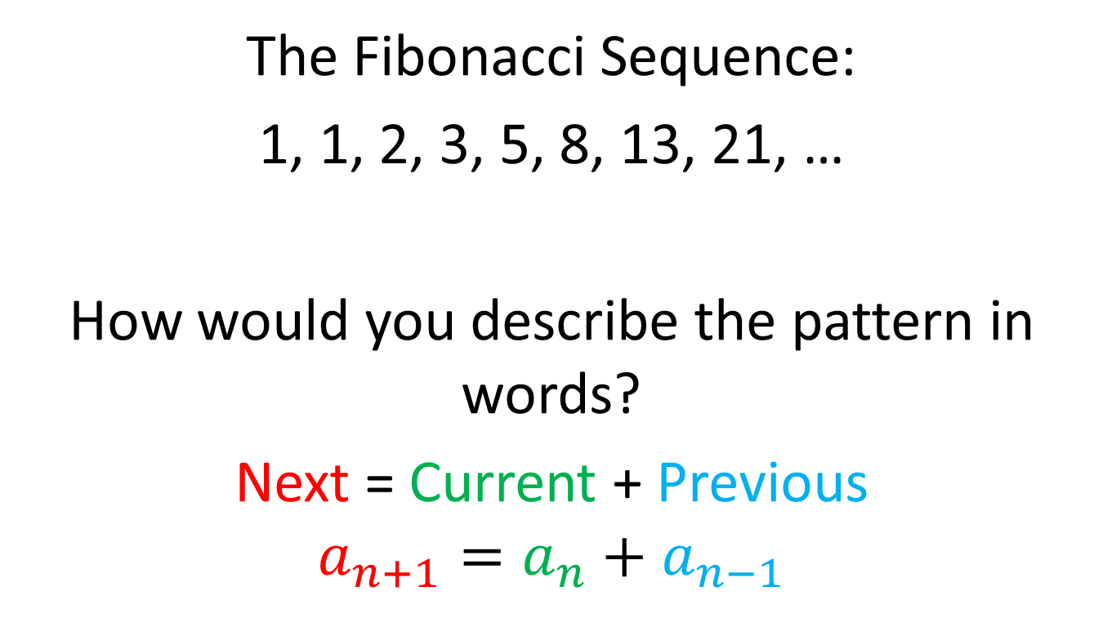
What is the pattern?
The Fibonacci Sequence:
1, 1, 2, 3, 5, 8, 13, 21, …
How would you describe the pattern in words?
Next = Current + Previous
$$a_{n+1}=a_{n}+a_{n−1}$$

Slide 4

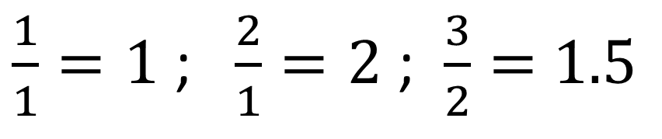
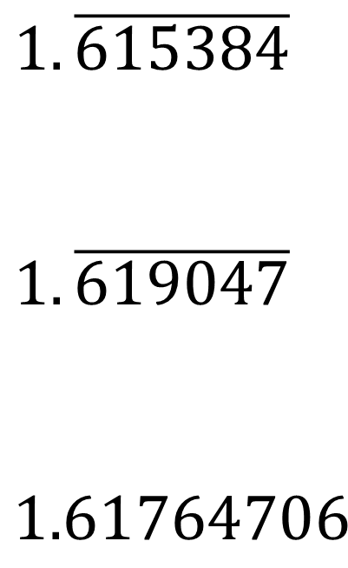

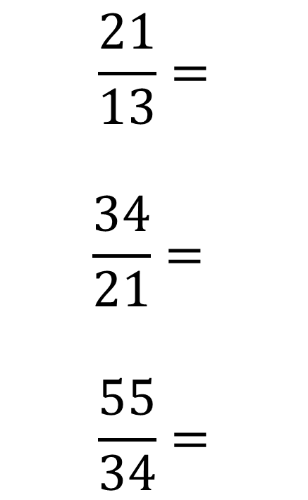
1, 1, 2, 3, 5, 8, 13, 21, 34, 55, …
$\frac{1}{1}=1$ ; $\frac{2}{1}=2$ ; $\frac{3}{2}=$ $1.5$
$$\frac{5}{3}=$$
$$\frac{8}{5}=$$
$$\frac{13}{8}=$$
$$\frac{21}{13}=$$
$$\frac{34}{21}=$$
$$\frac{55}{34}=$$
$$1.\overline{66}$$
$$1.6$$
$$1.625$$
$$1.\overline{615384}$$
$$1.\overline{619047}$$
$$1.61764706$$

Slide 5

Here are the next few:
$$\frac{89}{55}=1.61818\overline{18}$$
$$\frac{144}{89}=1.6179775$$
$$\frac{233}{144}=1.618055\overline{5}$$

Slide 6
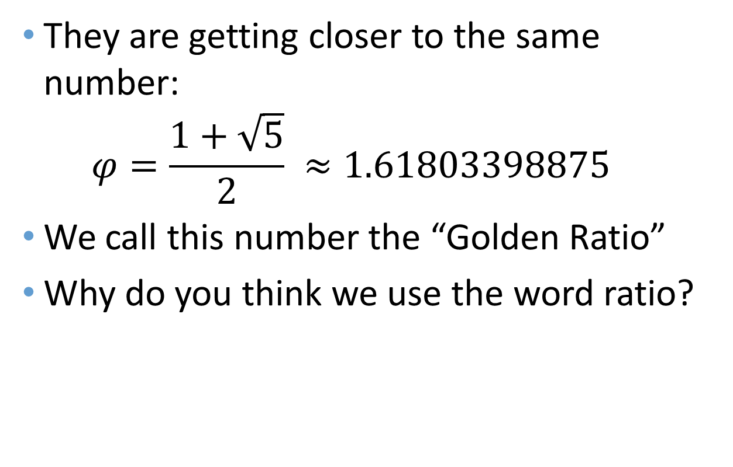
The Golden Ratio
They are getting closer to the same number:
$φ=\frac{1+\sqrt{5}}{2} ≈1.61803398875$
We call this number the “Golden Ratio”
Why do you think we use the word ratio?

Slide 7
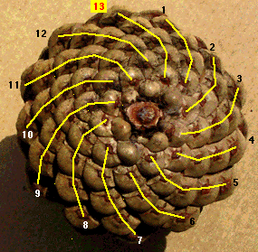
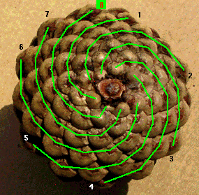
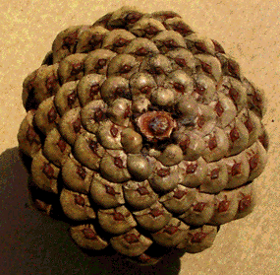
Why is the Golden Ratio Important?

Slide 8
Why do Plants do This?
http://www.mathsisfun.com/numbers/nature-golden-ratio-fibonacci.html
https://www.youtube.com/watch?v=ahXIMUkSXX0

Slide 9

Now for a change of Pace
Remember the quadratic formula?
If $ax^{2}+bx+c=0$ then $x=\frac{−b±\sqrt{b^{2}−4ac}}{2a}$
Let’s use it on the equation:
$x^{2}−x−1=0$
Solution:
$x=\frac{1±\sqrt{5}}{2}$

Slide 10

Why is that?
From Earlier: $a_{n+1}=a_{n}+a_{n−1}$
$$\frac{a_{n+1}}{a_{n}}=\frac{a_{n}+a_{n−1}}{a_{n}}$$
$$\frac{a_{n+1}}{a_{n}}=\frac{a_{n}}{a_{n}}+\frac{a_{n−1}}{a_{n}}$$
$$\frac{a_{n+1}}{a_{n}}=1+\frac{a_{n−1}}{a_{n}}$$
$$\frac{a_{n+1}}{a_{n}}=1+\frac{1}{\frac{a_{n}}{a_{n−1}}}$$

Slide 11

$$\frac{a_{n+1}}{a_{n}}=1+\frac{1}{\frac{a_{n}}{a_{n−1}}}$$
$$φ=1+\frac{1}{φ}$$
$$φ (φ=1+\frac{1}{φ})$$
$$φ^{2}=φ+1$$
$$φ^{2}−φ−1=0$$

